Slide 1


Discovering the Correlation between the Ozone, Pressure and Temperature and the Effects of Ozone on the Environment.
Dine College
Tsaile, Arizona
General Chemistry II
Cordell R. Chee, Eric Begay
Gilberta Yazzie & Shawntel Yessilth

Slide 2
Background
There are two major Coal Burning Power Plants that are within the Four Corners region: Arizona, Utah, Colorado and New Mexico.
Air pollution that comes from the West Coast (Majority of the Weather System comes from the West coast, which air pollution may increase within the Four Corner region.)
First group of students at Dine College that took an Interest in Ozone.

Slide 3
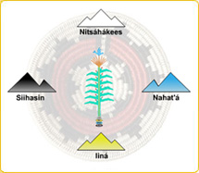
Navajo Perspective
From the Navajo perspective, we consider the Air as a Gift of Life and must be treated with respect.
It is said that “Air was the first thing we took as we entered this world and it will be the last thing we take as we leave this world.”
The educational philosophy of Diné College is
  “Sa'ah Naaghai Bik'eh Hozhoo”,
  the Diné traditional living system,
  that places Dine’ life in harmony with
  the natural world and the universe.
We also apply four major concepts:
  Nitsáhákees (Thinking), Nahat'á (Planning), Iiná (Living) and Sihasin (Assuring)

Slide 4
Experiment
Sensor/Moniter
Measures: Ozone (ppb), Temperature (K), Pressure (torr), and GPS.
Data log: 1 min., 5 min., & 1 hr
Measurements: 4” x 3” x 1.5”
Weight: 0.751 lbs.
Payload/Materials
Cardboard (4 pieces, 6.5” x 6.5”)
Hot glue gun
Heavy duty duct tape
Foam sponge
Weight: 1.1464 lbs.
Total Weight: 1.90 lbs

Slide 5
Condition of the Day of Launch
Weather Forecast
Balloon Route
Launched at 9 am from Dine College, Main Campus in Tsaile, Arizona.
Landed directly 99 miles East of Tsaile, Arizona.

Slide 6
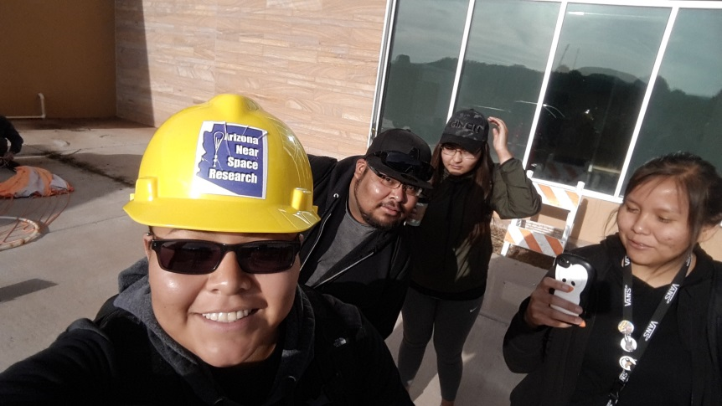
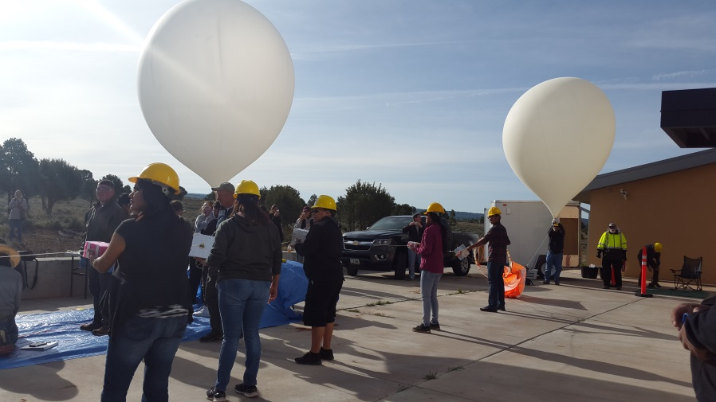
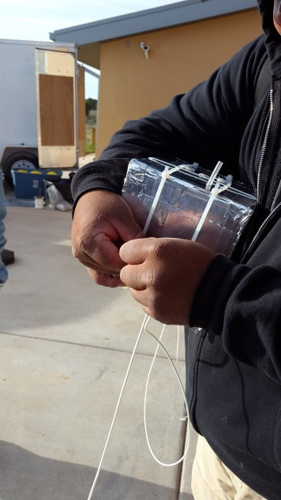
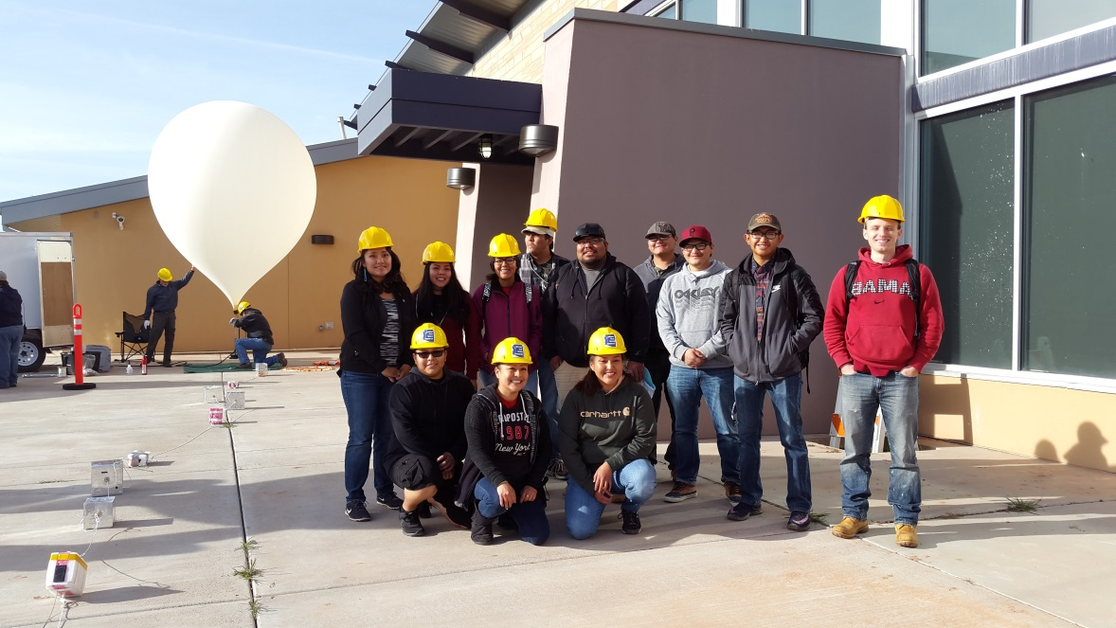
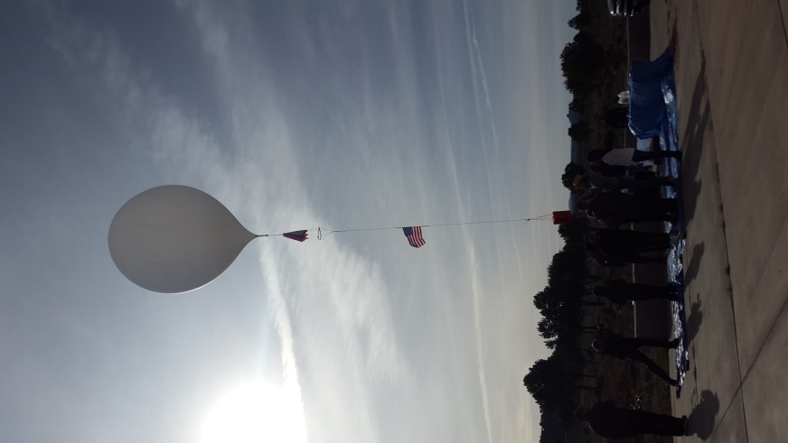
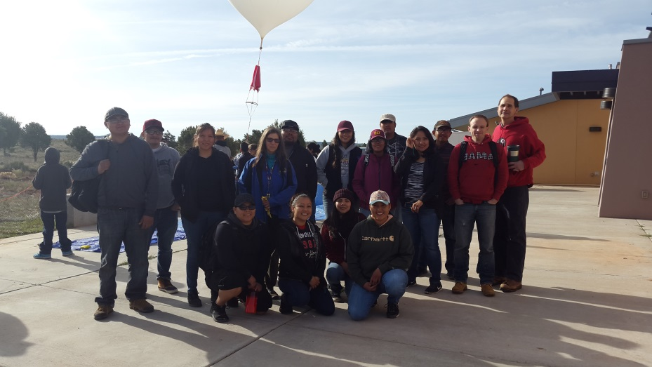
LAUNCH SITE

Slide 7
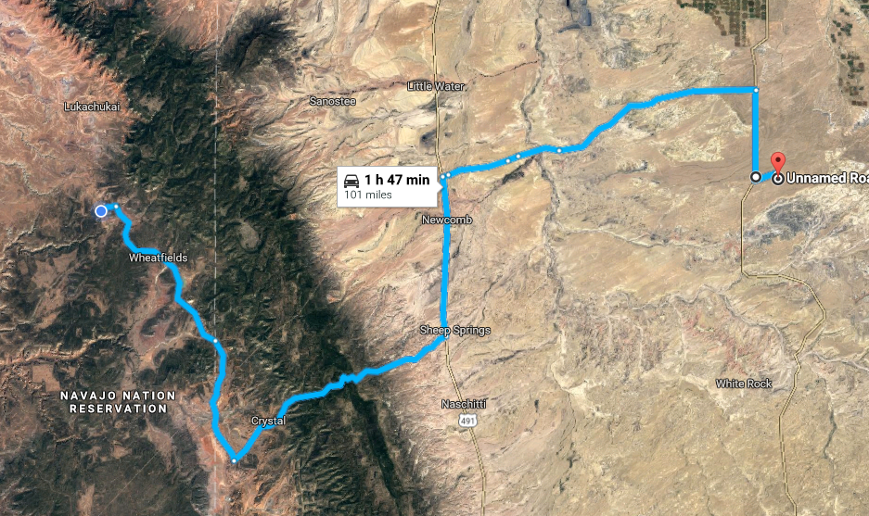
Route taken to Retrieve Balloon

Slide 8
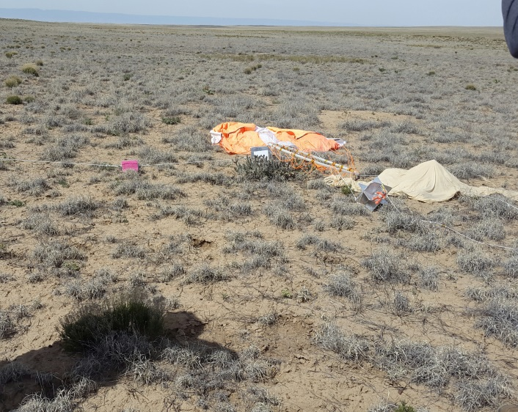
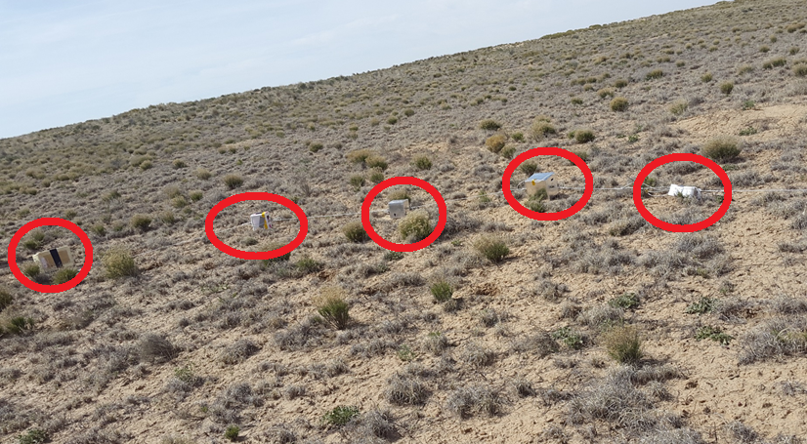
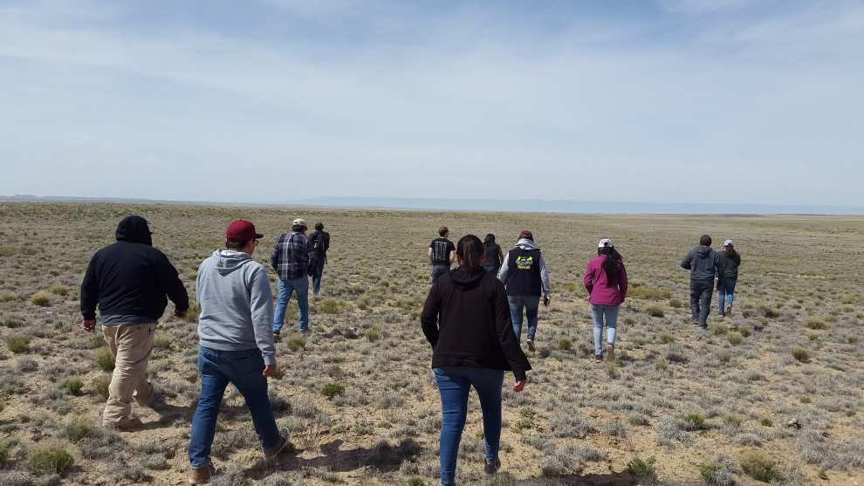
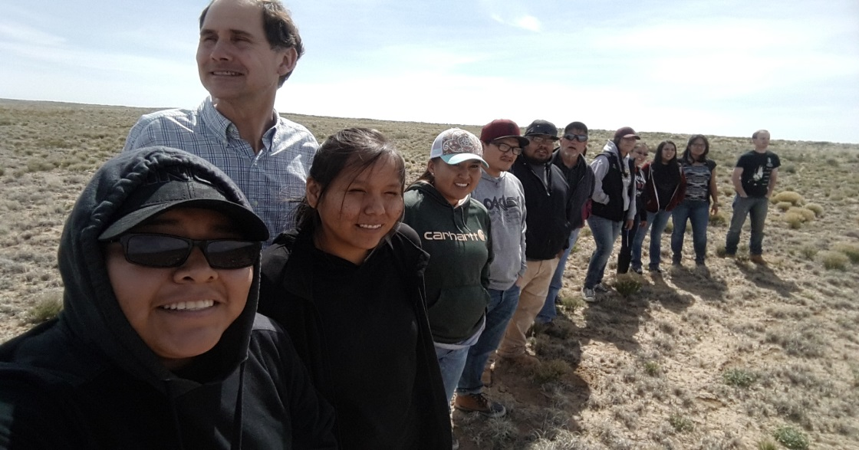
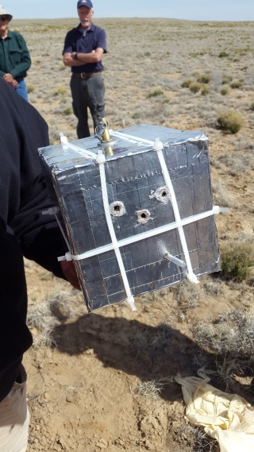
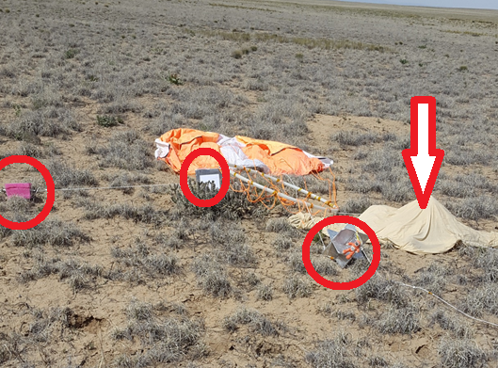
RETRIEVING SITE

Slide 9

Results
Ozone
Unfortunately, We were unable to Gather any Data. Therefore we decided to gather Ground level Ozone. As we gather ground level ozone, we walked around Dine College Campus with the POM, outdoor and indoor.
Pressure & Temperature
Again we were unable to gather any data relating to pressure and temperature at high attitude. So we asked another Group if we could use their Data that they were able to gather during the flight.

Slide 10

Analyze
High Attitude Ozone
Stratosphere Ozone
Contains about 90% of atmospheric ozone
Good ozone because it protects us from harmful UV radiation from the sun which may cause skin cancers & eye damage.
CFCs- Chlorofluorocarbons depletes the Ozone Layer.
Ground Level Ozone
Tropospheric Ozone
Contains about 10% ozone
Mainly from the automobiles exhaust or emissions, creating smog.
Bad because it is a type of pollution.

Slide 11
Issues
Trial Error(s)
Limited time to work with monitor.
Didn’t properly set the monitor to start logging in the data.
Possible malfunction: the monitor could only function as high as 82,000 feet.
Turning off monitor before transferring data.
Correction(s)
Order monitors/sensors a week after the topic selection has been made.
Read the manual promptly.
Altitude capability (require maximum altitude).
Immediately transferring data after retrieving payload.

Slide 12
Human Effects
Children, elders and people with health problems are at greater risk from breathing air containing Ozone.
Ozone may cause health issues such as chest pain, coughing, throat irritation, and airway inflammation. Also can reduce lung function and harm lung tissue.
It can worsen bronchitis, emphysema, and asthma, leading to increased medical attention.

Slide 13
Environmental Effects
Beneficial, Ozone (layer) serves as a barrier that surrounds the Earth’s, protecting us from Damaging Ultraviolet Radiation as well a Cosmetic Radiation.
Yet, may cause harm to the Environment, especially the vegetation. Primarily vegetation that is sensitive, or in other words, still in their early growth stage.
Vegetation in Forests, Rainforest, Grassland, even Fields that produce our food.

Slide 14
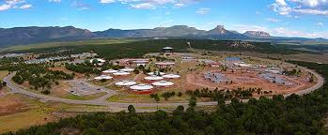
Acknowledgment
Susan Brew, Arizona Space Grant Consortium
Morgan Allers, 2B Technologies
Francis Burns, Chemistry Instructor
Dine College, Main Campus & Science Department

